Slide 1


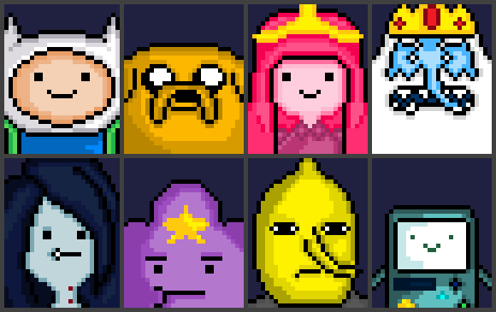
24h Hack4Good
U Waterloo
Computer Science
The Designer
Paul
Lucas
Angad
Cissy
U Waterloo
Software Engineering
Brown University
Computer Science
Notes:
mesassi@microsoft.com
425-435-8370

Slide 2
George
Uber Eat driver
Notes:
mesassi@microsoft.com
425-435-8370

Slide 3

George
or a single dad
Notes:
mesassi@microsoft.com
425-435-8370

Slide 4
George
got his first interview
Notes:
mesassi@microsoft.com
425-435-8370

Slide 5

George
got his first interview and… failed
Notes:
mesassi@microsoft.com
425-435-8370

Slide 6
George
wonders why…
cry
employers feedback
Look up online
friends
advisors
Gear Up
Notes:
mesassi@microsoft.com
425-435-8370

Slide 7
George
wonders why…
cry
employers feedback
Look up online
friends
advisors
Gear Up
Are my friends’ recommendations trustworthy
Awkward to ask…
Tooooooo many resources o.o
I don’t know what I don’t know…
What the hell is MEAN?!
Notes:
mesassi@microsoft.com
425-435-8370

Slide 8
George meets
Year Up
Notes:
mesassi@microsoft.com
425-435-8370

Slide 9
demo

Slide 10

Software Engineer
I want to be a
QA Tester
IT Help Desk
Teller
Desktop Support Technician

Slide 11
IT Help Desk
I want to be a
QA Tester
IT Help Desk
Teller
Desktop Support Technician

Slide 12
Quality Assurance
I want to be a
QA Tester
IT Help Desk
Teller
Desktop Support Technician

Slide 13
Software Engineer
I want to be a
QA Tester
IT Help Desk
Teller
Desktop Support Technician
S

Slide 14
Software Engineer
I want to be a
Software Engineer
Software Tester
Senior Teller
Senior Program Manager

Slide 15
Software Engineer
I want to be a
Software Engineer
Software Tester
Senior Teller
Senior Program Manager

Slide 16
Software Engineer
I want to be a
Software Engineer
Software Tester
Senior Teller
Senior Program Manager

Slide 17
Software Engineer
I want to be a
Software Engineer
Software Tester
Senior Teller
Senior Program Manager

Slide 18
Web Developer
I want to be a
Now, I know
HTML
CSS
JavaScript
jQuery
Team work
Presenting
I’m done

Slide 19
Software Engineer
I want to be a
Now, I know
HTML
CSS
JavaScript
jQuery
C
Fool
I’m done

Slide 20
Software Engineer
I want to be a
Now, I know
Java
C++
JavaScript
Go
C
Fool
I’m done

Slide 21
Software Engineer
I want to be a
Now, I know
Java
C++
JavaScript
Go
C
Fool
I’m done

Slide 22
Software Engineer
I want to be a
Now, I know
Java
C++
JavaScript
Go
C
Fool
I’m done

Slide 23
Software Engineer
I want to be a
Now, I know
Java
C++
JavaScript
Go
C
Fool
I’m done

Slide 24
Software Engineer
I want to be a
Now, I know
Java
C++
JavaScript
Go
C
Fool
I’m done

Slide 25
Software Engineer
I want to be a
Now, I know
Java
C++
JavaScript
Go
C
Fool
I’m done

Slide 26
Software Engineer
I want to be a
So I need to learn
C++
Go
C
Hold on… Preparing your study path…
Edit my selection

Slide 27
C++
C++ Basic at Year Up
Power up C++ with the Standard Template Library
Introduction to C++
C++ Programming
Go
A Tour of Go - The Go Programming Language
Go Programming in One Week
Introduction to Go Programming Language
Learn GoLang
C
C Programming
Learn C
Teach Yourself C in 24 Hours
C Programming For Beginners
I am now a 50% Software Engineer

Slide 28




C++
C++ Basic at Year Up
Power up C++ with the Standard Template Library
Introduction to C++
C++ Programming
Go
A Tour of Go - The Go Programming Language
Go Programming in One Week
Introduction to Go Programming Language
Learn GoLang
C
C Programming
Learn C
Teach Yourself C in 24 Hours
C Programming For Beginners
I am now a 50% Software Engineer

Slide 29




C++
C++ Basic at Year Up
Power up C++ with the Standard Template Library
Introduction to C++
C++ Programming
Go
A Tour of Go - The Go Programming Language
Go Programming in One Week
Introduction to Go Programming Language
Learn GoLang
C
C Programming
Learn C
Teach Yourself C in 24 Hours
C Programming For Beginners
I am now a 50% Software Engineer

Slide 30
C++
C++ Basic at Year Up
Power up C++ with the Standard Template Library
Introduction to C++
C++ Programming
Go
A Tour of Go - The Go Programming Language
Go Programming in One Week
Introduction to Go Programming Language
Learn GoLang
4.3★ · FREE · 1wk
C
C Programming
Learn C
Teach Yourself C in 24 Hours
C Programming For Beginners
I am now a 50% Software Engineer

Slide 31
C++
C++ Basic at Year Up
Power up C++ with the Standard Template Library
Introduction to C++
C++ Programming
Go
A Tour of Go - The Go Programming…
Go Programming in One Week
Introduction to Go Programming Language
Learn GoLang
4.9★ · FREE
C
C Programming
Learn C
Teach Yourself C in 24 Hours
C Programming For Beginners
I am now a 50% Software Engineer

Slide 32
C++
C++ Basic at Year Up
Power up C++ with the Standard Template Library
Introduction to C++
C++ Programming
A Tour of Go - The Go Programming Language
4.9★ · FREE
Go
Go Programming in One Week
Introduction to Go Programming Language
Learn GoLang
”Amazing level of detail, reference material, links. By far the best resource for learning Go I have come across.”
Recommended to you by Year Up 2015 Alumni, Software Engineer at Google, Ashley Smith
C
C Programming
Learn C
Teach Yourself C in 24 Hours
C Programming For Beginners
Start
I am now a 50% Software Engineer

Slide 33
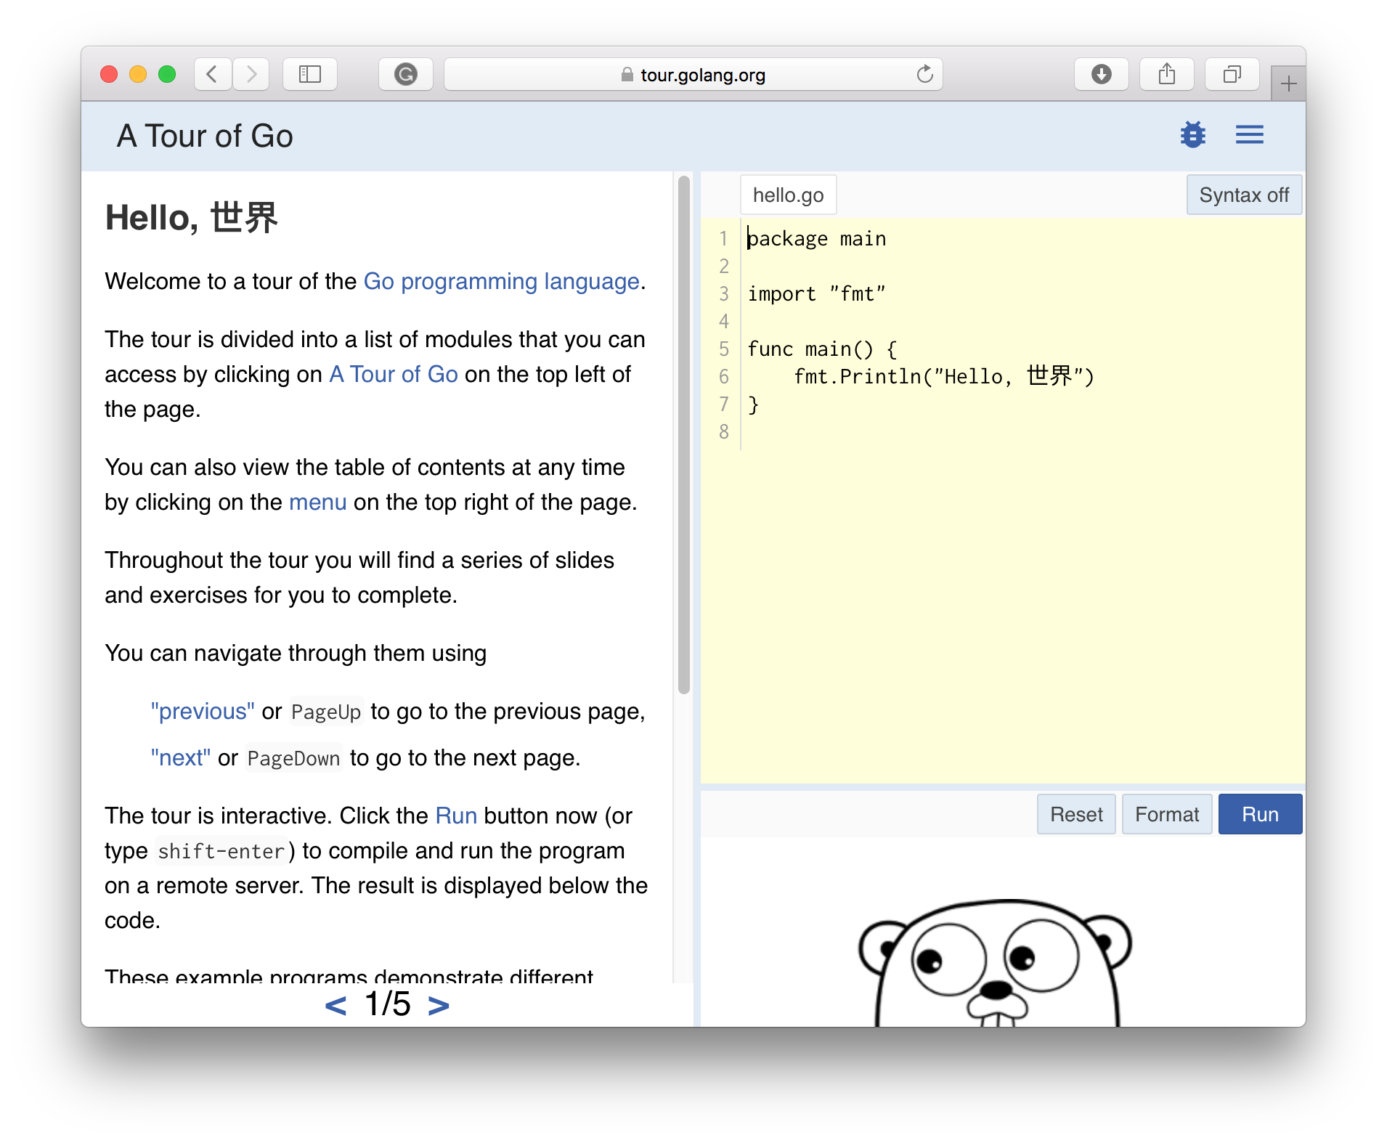
C++
C++ Basic at Year Up
Power up C++ with the Standard Template Library
Introduction to C++
C++ Programming
A Tour of Go - The Go Programming Language
4.9★ · FREE
Go
Go Programming in One Week
Introduction to Go Programming Language
Learn GoLang
”Amazing level of detail, reference material, links. By far the best resource for learning Go I have come across.”
Recommended to you by Year Up 2015 Alumni, Software Engineer at Google, Ashley Smith
C
C Programming
Learn C
Teach Yourself C in 24 Hours
C Programming For Beginners
Go
I am now a 50% Software Engineer

Slide 34
C++
C++ Basic at Year Up
Power up C++ with the Standard Template Library
Introduction to C++
C++ Programming
Go
A Tour of Go - The Go Programming Language
Go Programming in One Week
Introduction to Go Programming Language
Learn GoLang
In Progress
C
C Programming
Learn C
Teach Yourself C in 24 Hours
C Programming For Beginners
I am now a 50% Software Engineer

Slide 35
C++
C++ Basic at Year Up
Power up C++ with the Standard Template Library
Introduction to C++
C++ Programming
Go
A Tour of Go - The Go Programming Language
Go Programming in One Week
Introduction to Go Programming Language
Learn GoLang
In Progress
C
C Programming
Learn C
Teach Yourself C in 24 Hours
C Programming For Beginners
I am now a 50% Software Engineer

Slide 36
C++
C++ Basic at Year Up
Power up C++ with the Standard Template Library
Introduction to C++
C++ Programming
Go
A Tour of Go - The Go Programming Language
Go Programming in One Week
Introduction to Go Programming Language
Learn GoLang
In Progress
C
C Programming
Learn C
Teach Yourself C in 24 Hours
C Programming For Beginners
I am now a 50% Software Engineer

Slide 37
C++
C++ Basic at Year Up
Power up C++ with the Standard Template Library
Introduction to C++
C++ Programming
A Tour of Go - The Go Programming Language
Go to course
Mark as done
Abandon
Go
Go Programming in One Week
Introduction to Go Programming Language
Learn GoLang
C
C Programming
Learn C
Teach Yourself C in 24 Hours
C Programming For Beginners
In progress since yesterday
I am now a 50% Software Engineer

Slide 38
C++
C++ Basic at Year Up
Power up C++ with the Standard Template Library
Introduction to C++
C++ Programming
A Tour of Go - The Go Programming Language
Go to course
Mark as done
Abandon
Go
72% of your friends completed this course.
Go Programming in One Week
Introduction to Go Programming Language
Learn GoLang
C
C Programming
Learn C
Teach Yourself C in 24 Hours
C Programming For Beginners
In progress since yesterday
I am now a 50% Software Engineer

Slide 39
C++
C++ Basic at Year Up
Power up C++ with the Standard Template Library
Introduction to C++
C++ Programming
Go
A Tour of Go - The Go Programming Language
Go Programming in One Week
Introduction to Go Programming Language
Learn GoLang
C
C Programming
Learn C
Teach Yourself C in 24 Hours
C Programming For Beginners
I am now a 50% Software Engineer

Slide 40
C++
C++ Basic at Year Up
Power up C++ with the Standard Template Library
Introduction to C++
C++ Programming
A Tour of Go - The Go Programming Language
Go
Go Programming in One Week
Introduction to Go Programming Language
Learn GoLang
C
C Programming
Learn C
Teach Yourself C in 24 Hours
C Programming For Beginners
I am now a 50% Software Engineer

Slide 41
C++
C++ Basic at Year Up
Power up C++ with the Standard Template Library
Introduction to C++
C++ Programming
A Tour of Go - The Go Programming Language
Go
Go Programming in One Week
Introduction to Go Programming Language
Learn GoLang
C
C Programming
Learn C
Teach Yourself C in 24 Hours
C Programming For Beginners
I am now a 50% Software Engineer

Slide 42
C++
C++ Basic at Year Up
Power up C++ with the Standard Template Library
Introduction to C++
C++ Programming
C
C Programming
Learn C
Teach Yourself C in 24 Hours
C Programming For Beginners
Go
I am now a 50% Software Engineer

Slide 43
C++
C++ Basic at Year Up
Power up C++ with the Standard Template Library
Introduction to C++
C++ Programming
C
C Programming
Learn C
Teach Yourself C in 24 Hours
C Programming For Beginners
Go
I am now a 67% Software Engineer

Slide 44
Communicating Strategically
Communicating Strategically
Communicating Strategically
4.1★ · FREE · 3wk
I am now a 50% Software Engineer

Slide 45
C++
C++ Basic at Year Up
Power up C++ with the Standard Template Library
Introduction to C++
C++ Programming
C
C Programming
Learn C
Teach Yourself C in 24 Hours
C Programming For Beginners
I am now a 67% Software Engineer

Slide 46
✕
Software Engineer
I want to be a
Learn more about
Java
JavaScript
Go
Fool
C
C++
I am now a 67% Software Engineer

Slide 47

✕
Software Engineer
I want to be a
Learn more about
Java
JavaScript
Go
Fool
Java Basic at Year Up
Power up Javawith the Standard Template Library
Introduction to Java
Java Programming
Java, Java and more Java
C
C++
I am now a 67% Software Engineer

Slide 48
Why Gear Up?
Empower users to
Identify the skills to excel in their role
Customize their own skills
Work through recommendations
Notes:
mesassi@microsoft.com
425-435-8370

Slide 49
Future
Recommendations generated from Machines Learning or experts
Extensible to be corporate training systems
Gamified experiences
Personalized experience base on learning style (practice/video/doc)
Sending progress reports
Notes:
mesassi@microsoft.com
425-435-8370

Slide 50
U Waterloo
Computer Science
The Designer
Paul
Lucas
Angad
Cissy
U Waterloo
Software Engineering
Brown University
Computer Science
Notes:
mesassi@microsoft.com
425-435-8370

